Slide 1
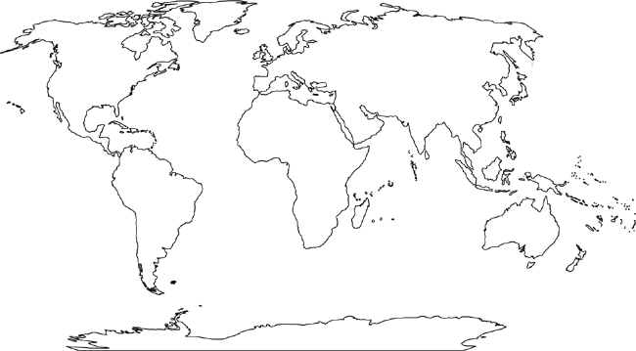

Slide 2
Name__________________ Date________ Period___________
Agricultural Mapping Activity Climate Regions
Using the maps on pages 352-355 and Ch. 11, answer the following questions or label the information on the map.
Subsistence Agricultural
Label and shade in on the map the location of Shifting Cultivation. Shifting Cultivation is found primarily in ___________ climate regions.
______________ is the practice of seasonal migration of livestock between mountains and lowland pasture areas. Label and Shade in on the map.
Label and Shade in the agricultural practice that is found at or just below the Equator and above the Tropic of Capricorn.
Intensive subsistence wet rice not dominant areas produce _____________ and ____________, because the climate is too dry for ____________ production. Label and Shade each individually on the map.
_______________________agriculture is predominantly found in the Highlands Climate region.
________________ is the only commercial agriculture found in the tropics. Identify which areas of the world see this type of commercial agriculture.
Many times subsistence agriculture is presumed to be less harmful to the environment. Explain what geographic factor might lead opinions to lean in that direction.
Identify which form of subsistence farming has the largest affect on the environment and explain why this is the case.
Follow the steps for identifying information on the map or answer the questions directly paper.
Commercial Agriculture
9. Label and Shade in on the map Commercial Ranching. Ranching cattle is found primarily in what climate region _______________. Ranching seems to have two universal geographic features besides climate ___________ and ______________.
10. ________ _________ is type of agriculture seen primary in U.S southeast. Where does the name originate from? _______________________
Label and shade in the location of Dairy Farming. Dairy Farming is found primarily in _______________ climate regions.
The Midwestern region of the United States is often referred to as the ‘Bread Basket’ of the world, but we have less land devoted than ____________ and __________ to grain farming. Explain what factors may lead to this difference in production.
Explain how cattle ranching has changed in the United States?
What is the difference between winter wheat and spring wheat?
The production of _____________ has limited the expansion of agricultural production in some LDC’s and NIC’s. These products are mostly sold in _________.

