Slide 1
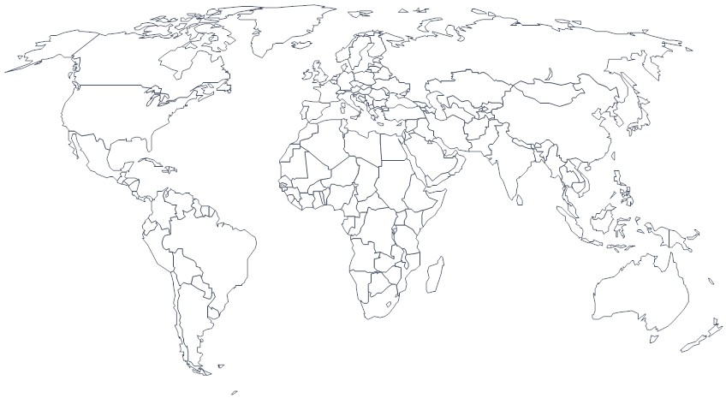
Historical US International Immigration Trends
Directions: Create a flow line map from the reading of the major US historical immigration trends. Make a key in the box provided labeled by time periods. Be sure to record from where the immigrants are coming from (region and major countries).
Key:
17/18th Centuries
1840-50
1870’s
1880’s
1905-14
Late 20th and Early 21st Century

Slide 2
Migrations between regions of the US
Irections

