Slide 2
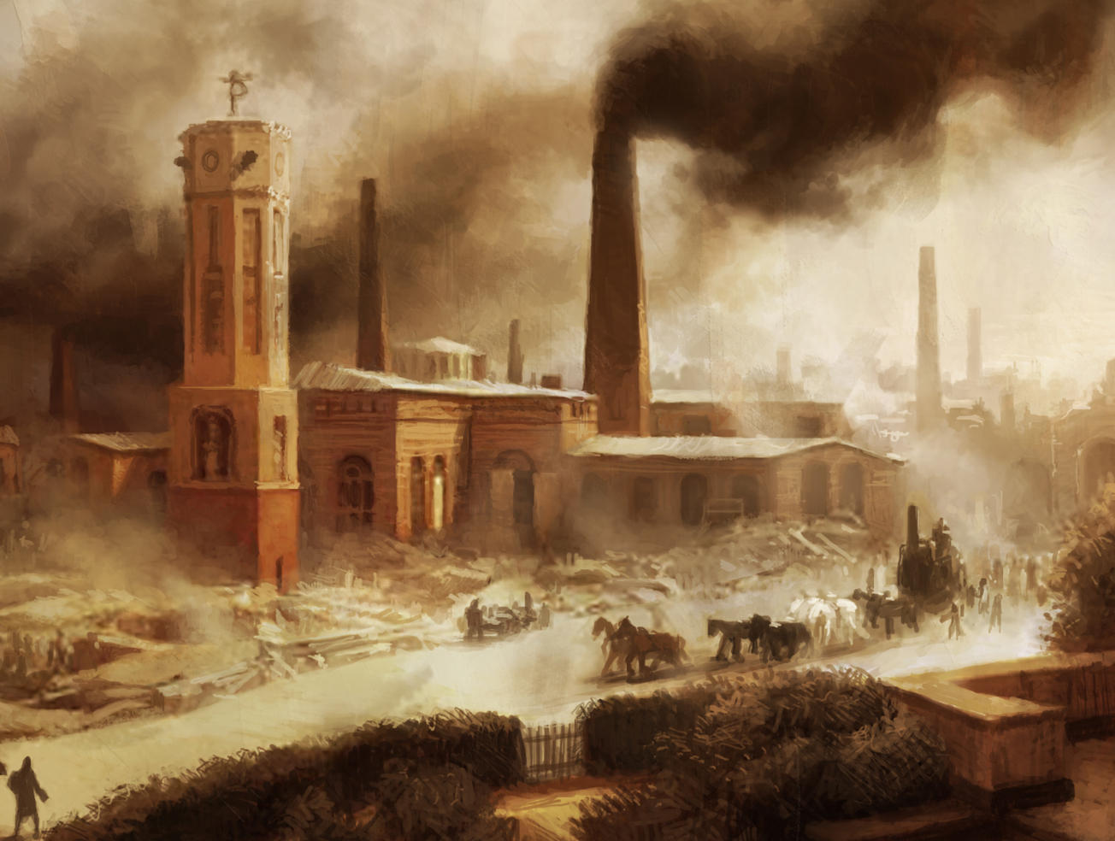
Industrialization
Notes:
Each segment following runs for 5 minutes.

Slide 3
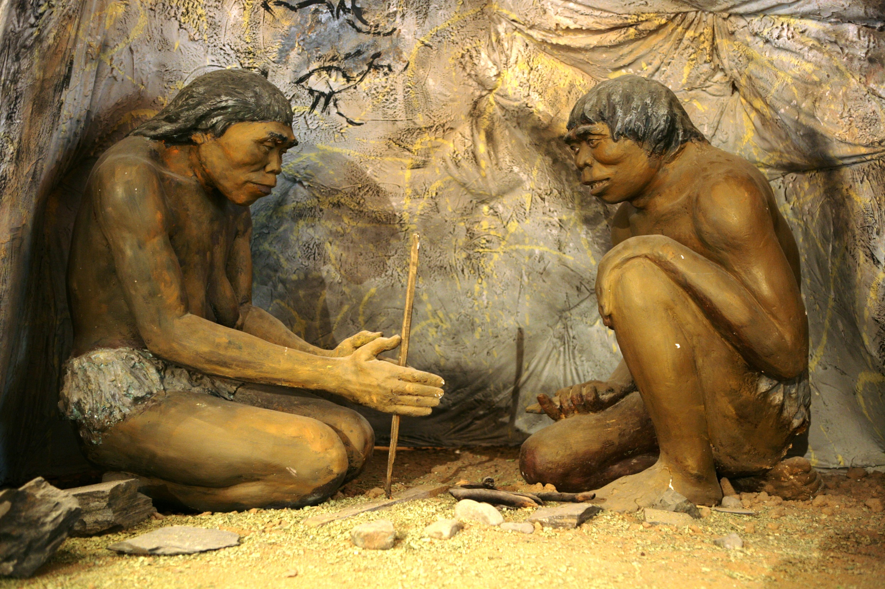
D.I.Y.
Notes:
Cave man – works alone, no tools.
Show students a completed Whirlygig but do not give them instructions. Provide them with blank paper but no paper clips. Have them create as many functional ones as possible in 5 minutes.

Slide 5
How to Make a Whirlygig
Cut paper into a strip about 6 inches long and 2 inches wide.
Cut the middle of one side of the strip about half way up the paper.
Fold the newly cut tabs back in opposite directions.
Attach a paper clip to the bottom. Test the product.

Slide 6
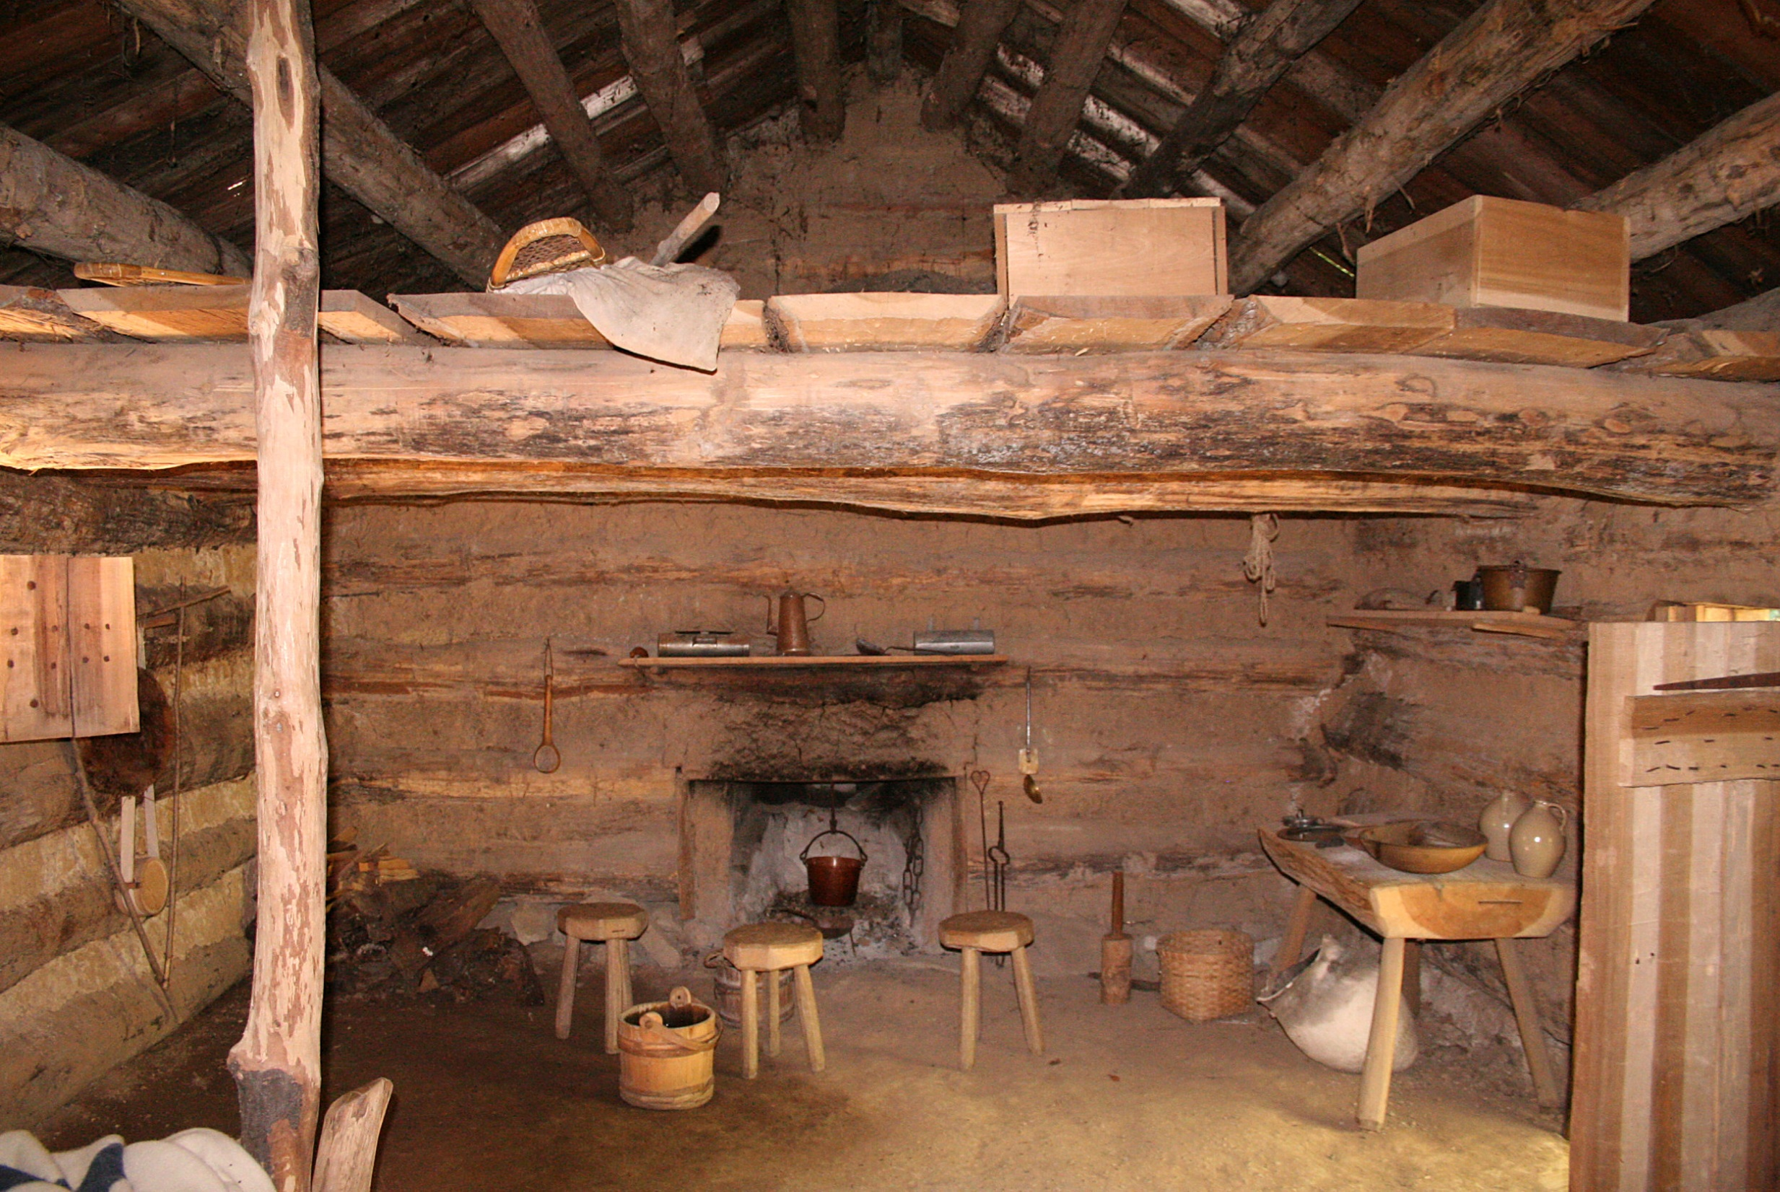
Cottage Industry
Notes:
[Cottage Industry] You sit at a workbench in your own home, add scissors, rulers (saw sound effects) and instructions (to simulate master/apprentice model).

Slide 7
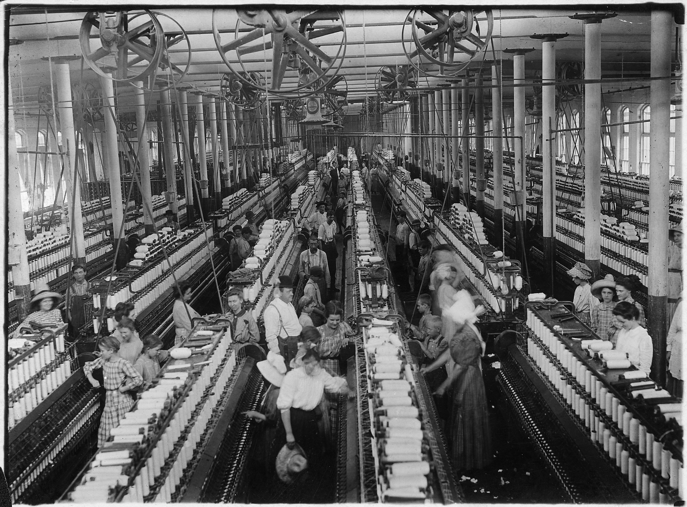
Early Factories
Notes:
Divide into groups of 4-6 and have students divide the labor. Provide them with paper clips (interchangeable parts!) to help facilitate the process.

Slide 8
Factory with Overseer
Notes:
Assign overseers to each group (using all males if your numbers allow). Instruct the workers to remain in complete silence as they work this time. Overseers enforce the rule.

